Slide 1
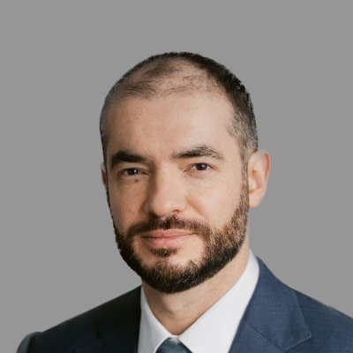
Ilya Sutskever
Luke Jansen

Slide 2
Early Life and Education
Born in the USSR – moved to Israel at 5 years – Toronto at 16 years
University of Toronto – B.S. Math, M.S., PhD. CS
Doctoral advisor was Geoffrey Hinton – (bio on Hinton)

Slide 3
AlexNet
Built AlexNet in collaboration with Geoffrey Hinton and Alex Krizhevsky
First time using GPUs to train image recognition
Led to huge leap in AI research
Google Brain
Helped create the sequence-to-sequence learning algorithm
Worked on TensorFlow
Co-authored the AlphaGo

Slide 4
OpenAI
Left Google in 2015 to cofound Open AI
Established OpenAI’s scaling ethos
Co-lead “superalignment” project
Tried to solve the alignment of superintelligences
After Sam Altman firing and rehire, he stepped down and founded Safe Superintelligence Inc.

Slide 5
Influence / Current Work
The remainder of the presentation should focus on their key contributions to the field of CV. Talk about the person's influential ideas, papers, or projects and their impact.

